Slide 1


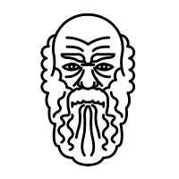







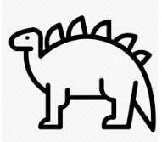






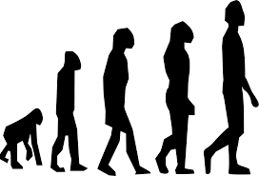


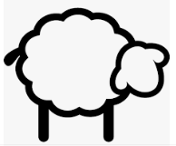

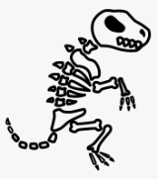














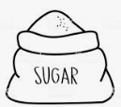




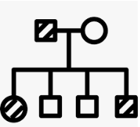














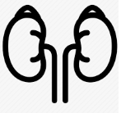


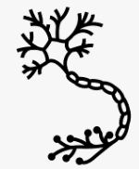












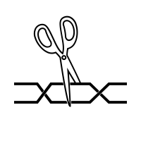



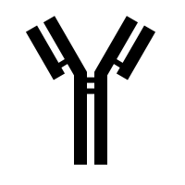

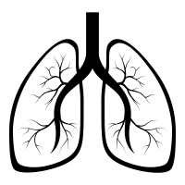




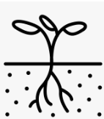



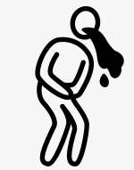


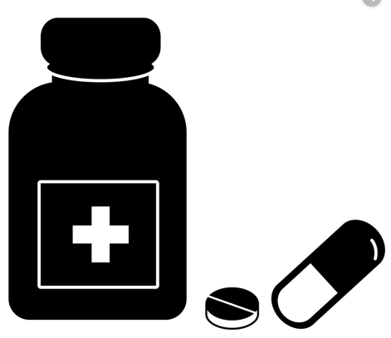

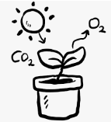
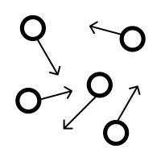

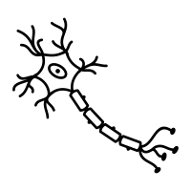






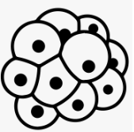



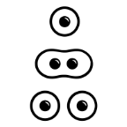


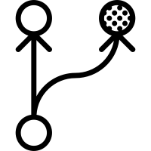

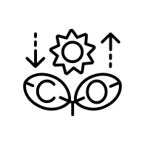

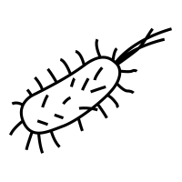

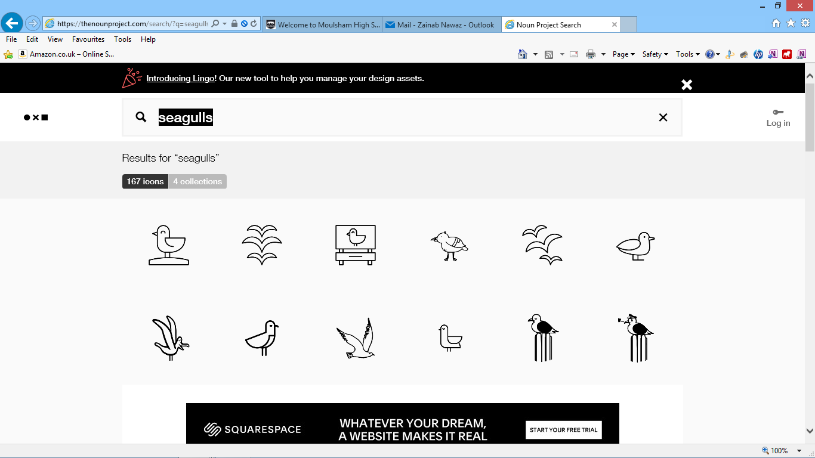



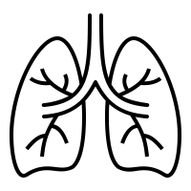









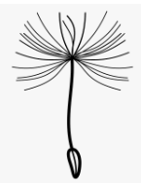
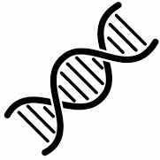


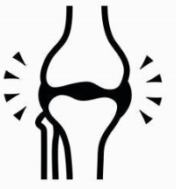





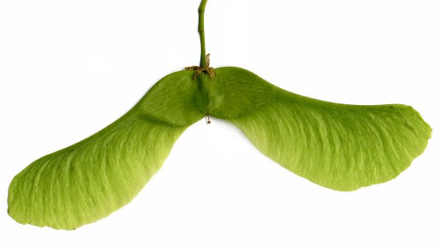
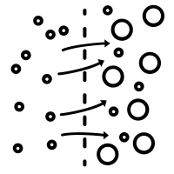


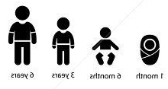




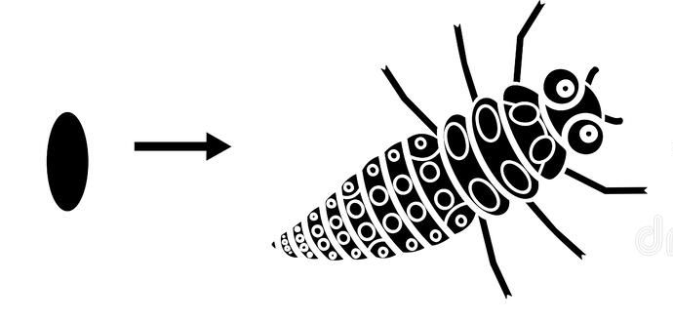
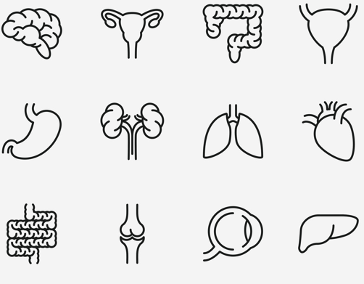

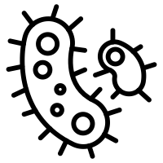
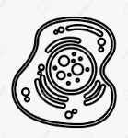

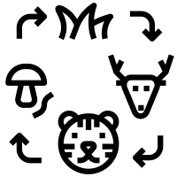
Biology Learning Journey
Year 7
Understanding and Applying Scientific Skills
Year 11
Plant organ systems
Writing methods
Assessing impact of scientific concepts
Understanding relationships between science and society
IDEAL
Identify, describe, explain, apply, link
Risk Assessment
Exam & Post – 16
Destination
Understanding variables
Drawing graphs and analysing graphical data
Analysis of secondary data
Modelling scientific concepts
Drawing conclusions
Applying maths to scientific concepts
Describe and explain patterns
Ethics of genetic engineering
Extinction
Communities
Environmental change
Sustainable fishing
Theories of evolution- Darwin
Speciation
Antibiotic resistant bacteria
Evidence for evolution
Food chains
Water cycle
RP10 Decomposition of milk
Biodiversity
Global warming
Trophic levels
Pyramid of biomass
Farming techniques
Evolution by natural selection
7) Ecology
Biotechnology
& evolution
Cloning
History of genetics
Fossils
Abiotic and Biotic factors
Carbon cycle
Deforestation and land use
Waste management
Transfer of Biomass
Factors affecting food security
Sustainable food production
Selective breeding
Genetic engineering
Classification
RP9 Sampling
variation
Variation
Protein synthesis
RP7 Reflexes
6) Inheritance,
Sex inheritance
RP8 Plant hormones
Balancing water and nitrogen levels
Controlling blood glucose
Genetic disorders
Meiosis
Diabetes
Thermoregulation
The Brain
Homeostasis
11
5) Homeostasis and Response
YEAR
Gene expression and mutations
The genome
Sexual and asexual reproduction
Fertility and IVF
Menstrual cycle
Problems with the eye
Structure and function of the nervous system
Response to exercise
DNA structure
Contraception
Endocrine system
Structure of the eye
Metabolism
Aerobic respiration
Anaerobic respiration
RP5 pH affect on enzymes
Vaccinations
Monoclonal antibodies
RP6 Effect of Light on Photosynthesis
Heart
Lungs
Blood
Lifestyle and disease
Cancer
Pathogens
Drug development
Plant defence
4) Bioenergetics
Maximizing photosynthesis
Enzymes
2) Organisation
3) Infection & Response
Uses of Glucose
Digestive system
Rate of photosynthesis
Specialised exchange surfaces
RP4 Food tests
Blood vessels
Non- communicable disease
Plant tissues and organs
Diseases and symptoms
Human defense systems
Antibiotics and Painkillers
RP2 Testing antimicrobials
Plant disease
Photosynthesis reaction
Active Transport
RP3 Osmosis
Healthy diet
Diffusion
Chromosomes
Maintaining biodiversity
Anerobic respiration in yeast and mammals
Cell specialisation
Natural selection
Aerobic respiration
1) Cell Biology
Pathogens
Atmosphere and food chains
Stem cells
YEAR
Exercise
Cell division: mitosis
10
Evolution
Health
Bioenergetics
RP1 Microscopy
Prokaryotic and eukaryotic cells
Adaptation and evolution
Variation
Effects of smoking
Good and ill health
Photosynthesis equation
Drugs
Plant adaptations
YEAR
Plant reproduction
Pollination
Digestive system
9
Heredity
Lungs
Skeleton
Classification
Fossil evidence
Development of a fetus
YEAR
Inheritance
Cells to Organs
Variation & Classification
8
Seed dispersal
DNA and the genome
Enzymes in digestion
Heart and blood
Muscles and joints
Variation
Biodiversity
The menstrual cycle
Reproduction
Fertilisation and implantation
Specialised cells
7 life processes
Puberty
Diffusion
Microscopy
Habitats
YEAR
Cells
Core Biology
7
Reproductive systems
Life cycles
Levels of organisation
Unicellular organisms
Organelles
Plant and animal cells
Energy in food chains
Food chains and webs
Note: In KS4 Exact teaching order within a year may vary for combined and separate students to spread practical work between groups and allow locked papers to be used effectively as exam preparation

